Slide 1
An Analysis of Competing Flows Over a Satellite Link
Kush Shah ‘23, kshah2@wpi.edu

Slide 2
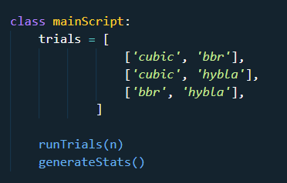
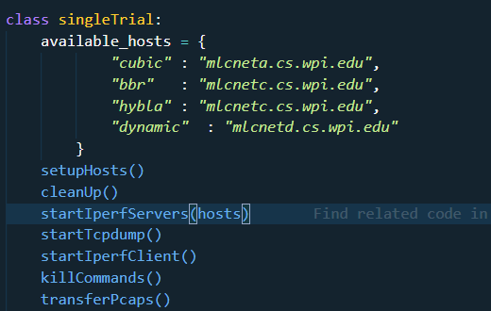

The Experiment

Slide 3
Conditions
Proxy off
hyStart disabled for cubic
All One Gigabyte transfers

Slide 4
Some difficulty
There was an issue with the Iperf connection terminating prematurely causing odd results.
Changing the congestion control protocol on the servers did not always work
Keeping the network busy

Slide 5
Example graphs

Slide 6
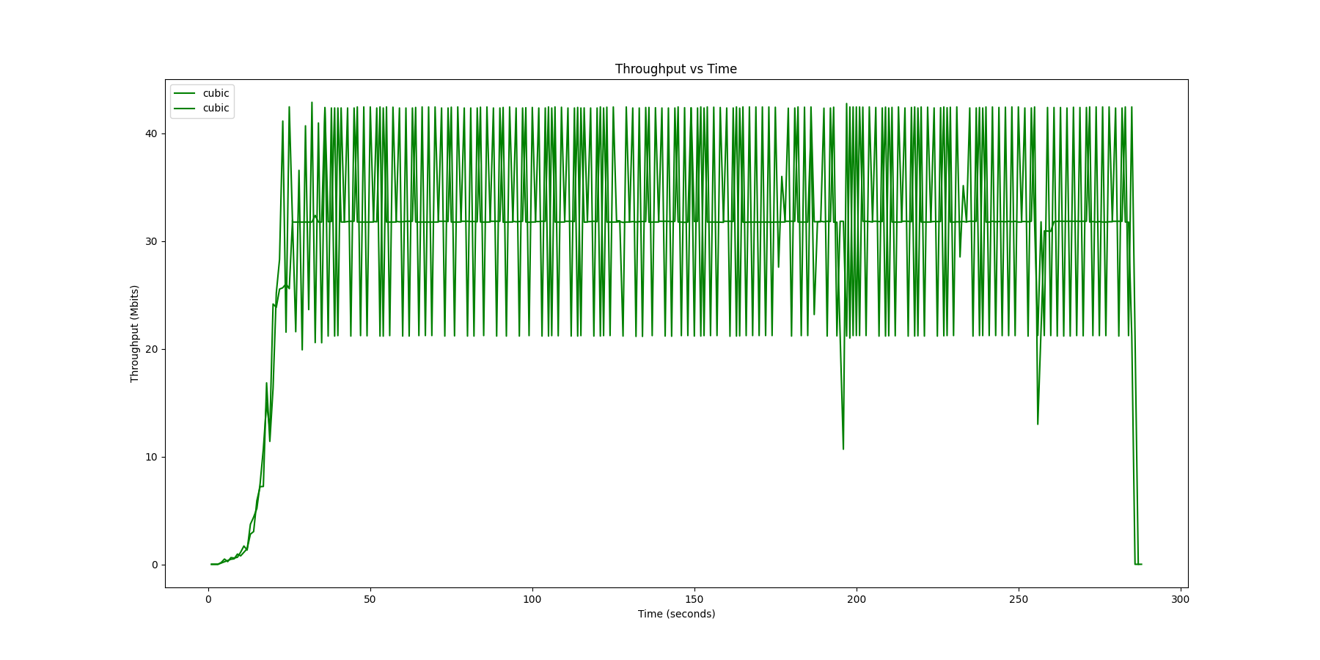
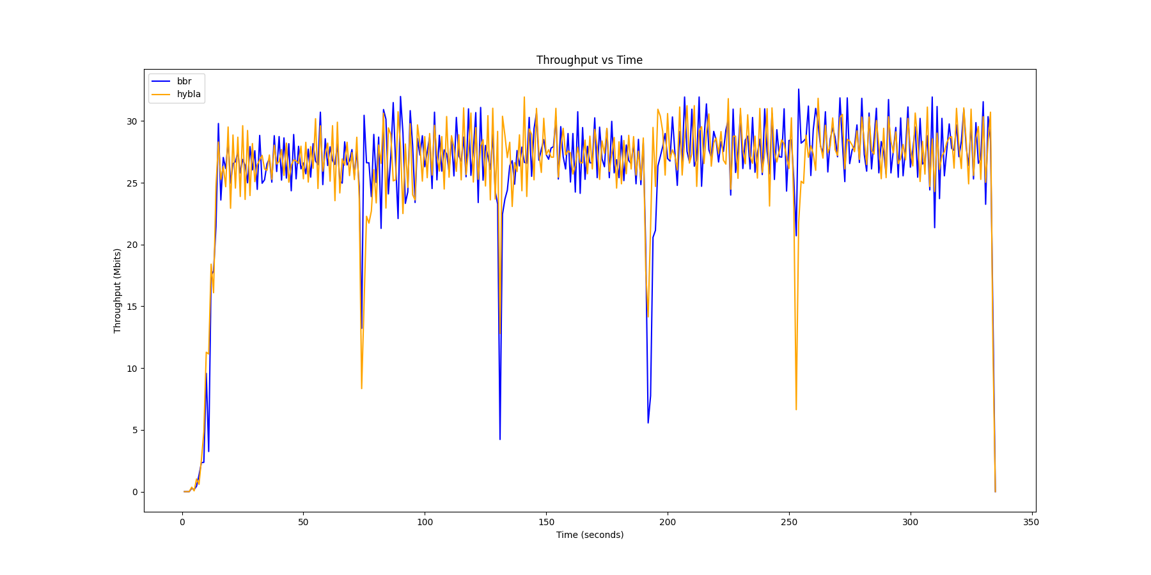
Example Graphs

Slide 7
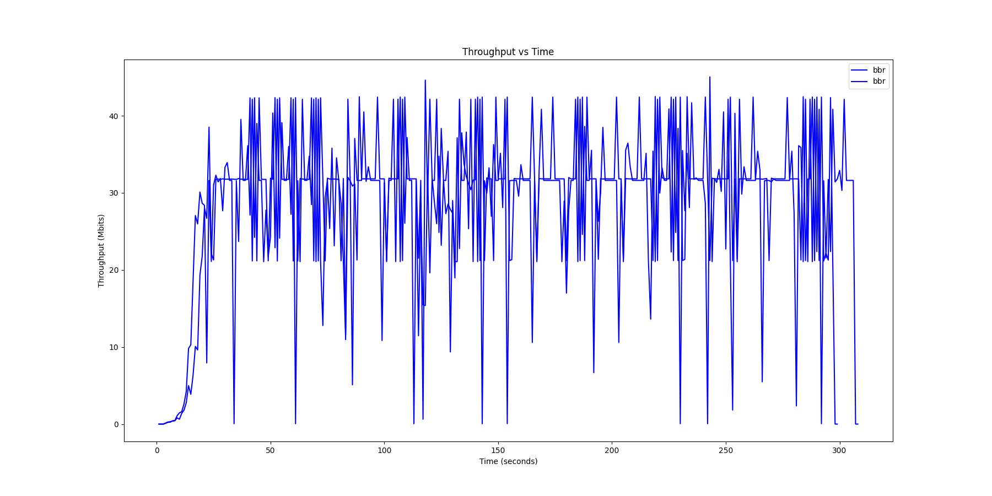
Example Graphs

Slide 8
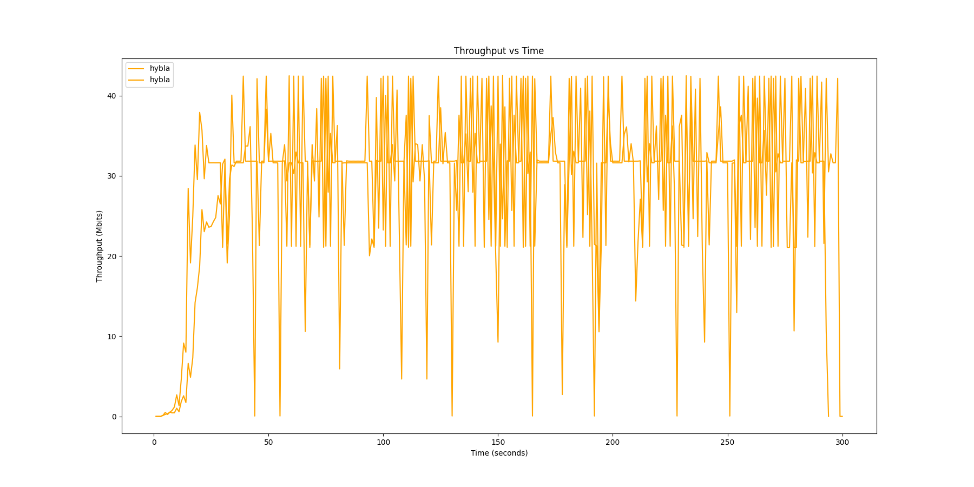
Example Graphs

Slide 9
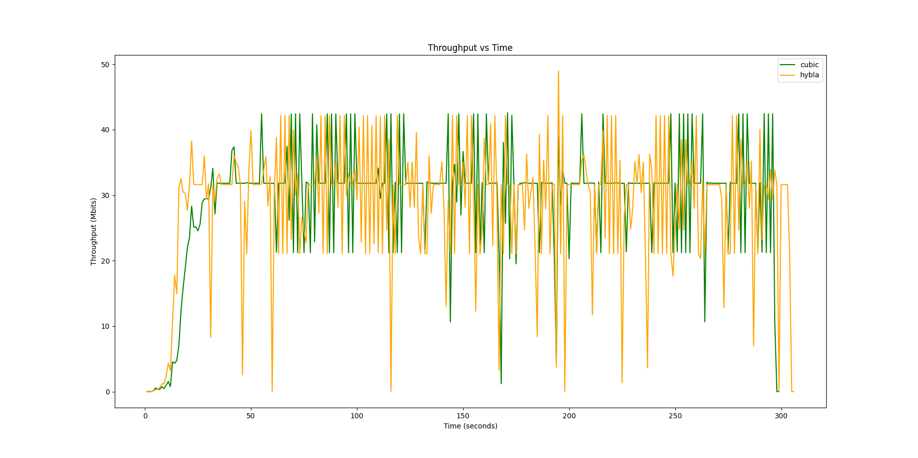
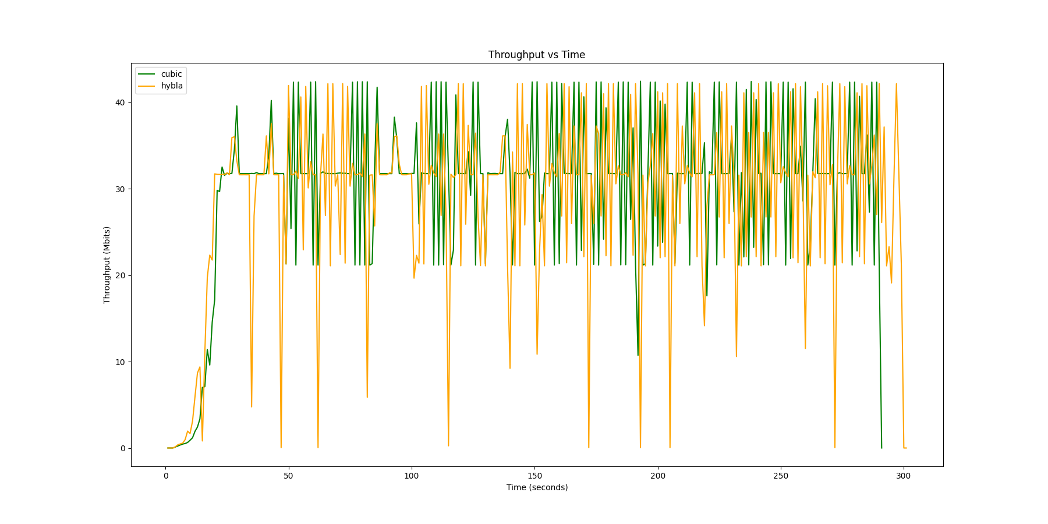
Example Graphs

Slide 10
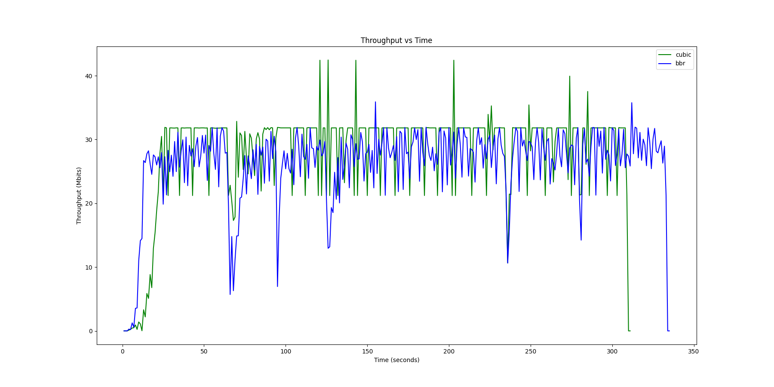
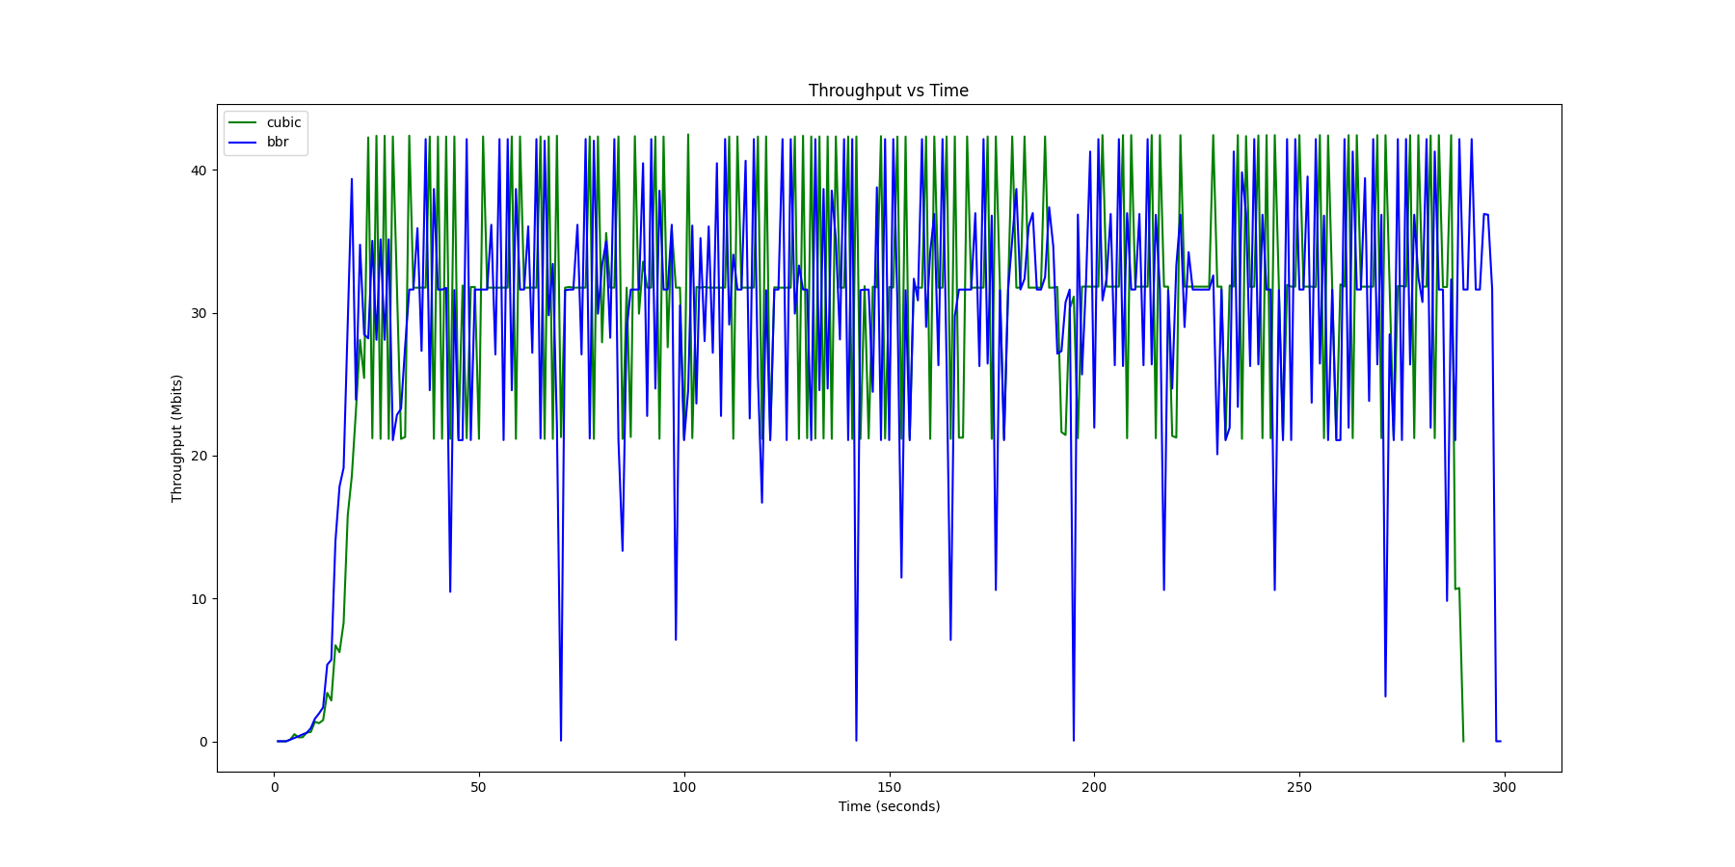
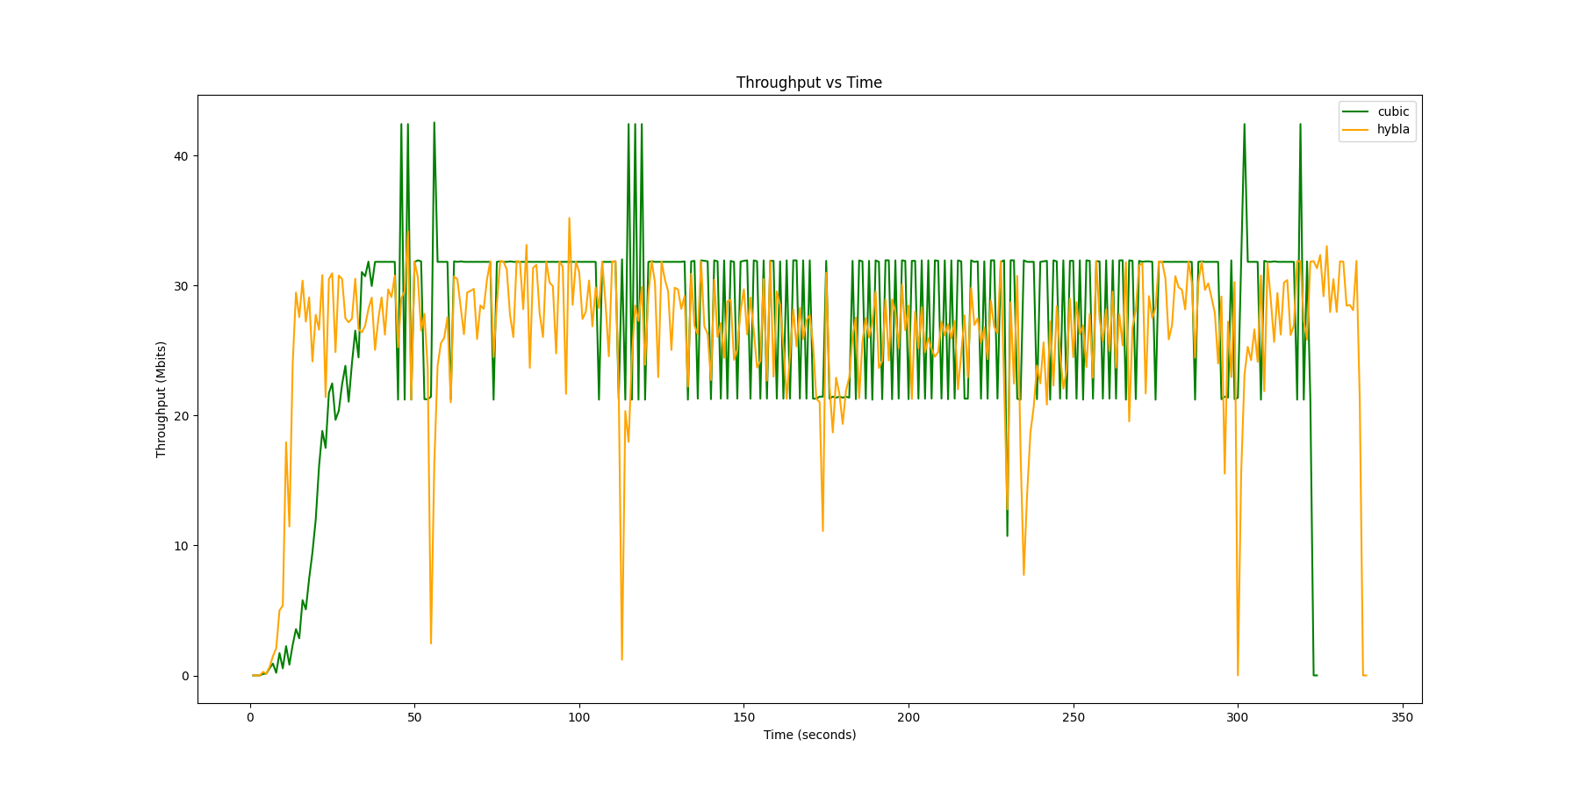
Example Graphs

Slide 11
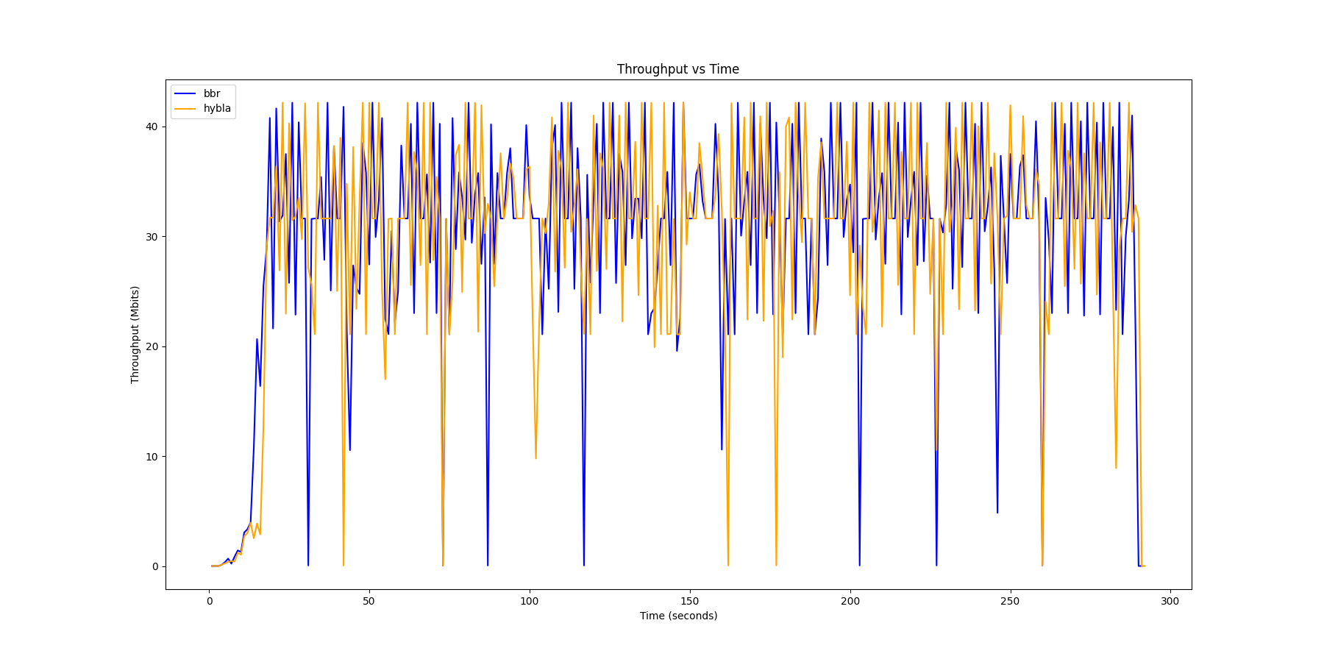
Example Graphs

Slide 12
Standout graphs

Slide 13
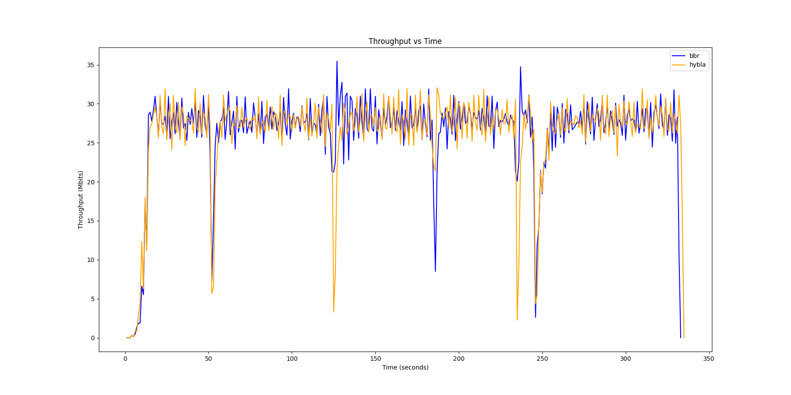
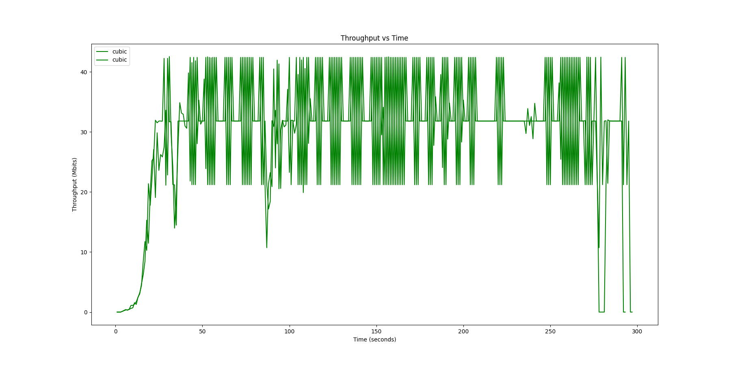
Example Graphs

Slide 14
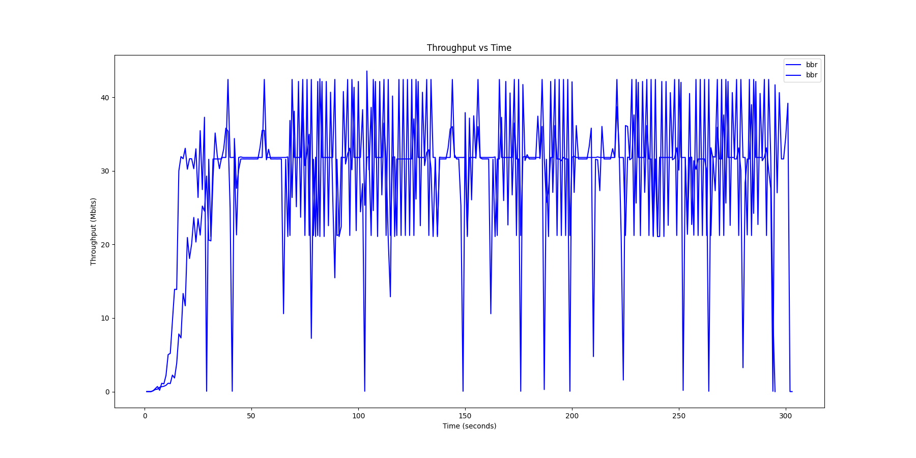
Example Graphs

Slide 15
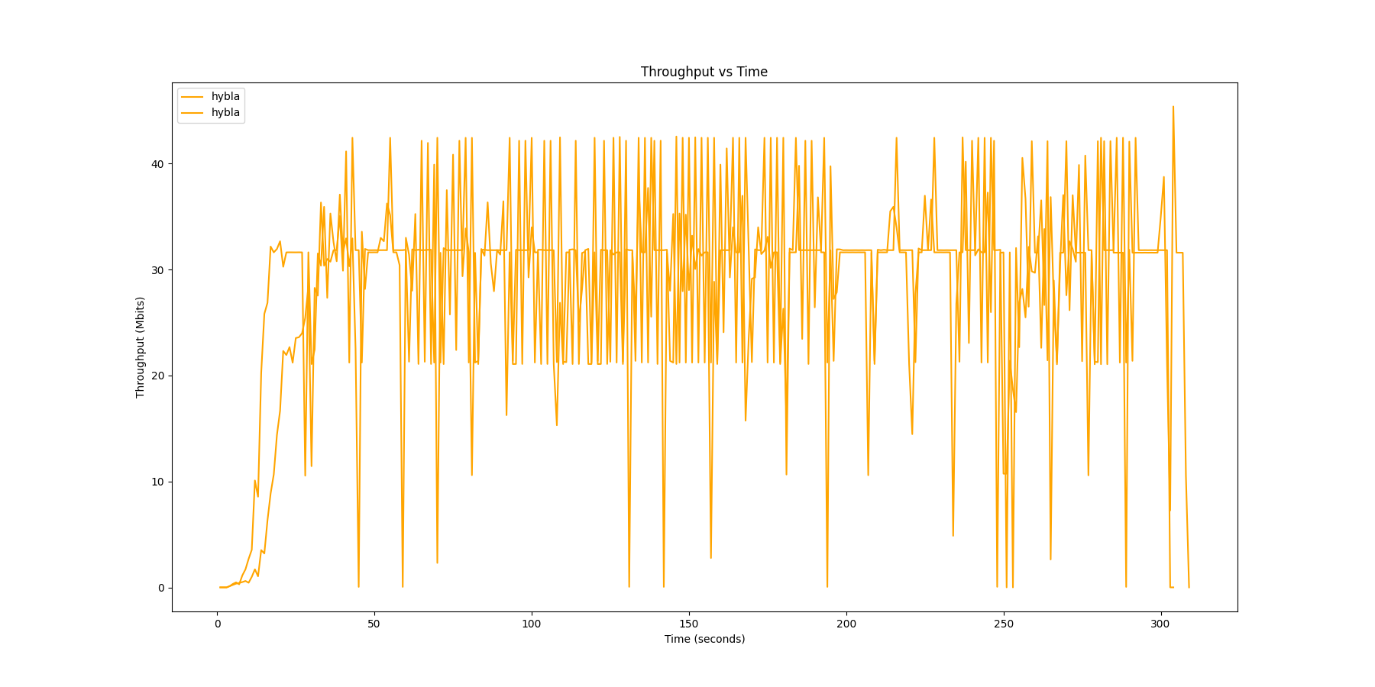
Example Graphs

Slide 16
Example Graphs

Slide 17
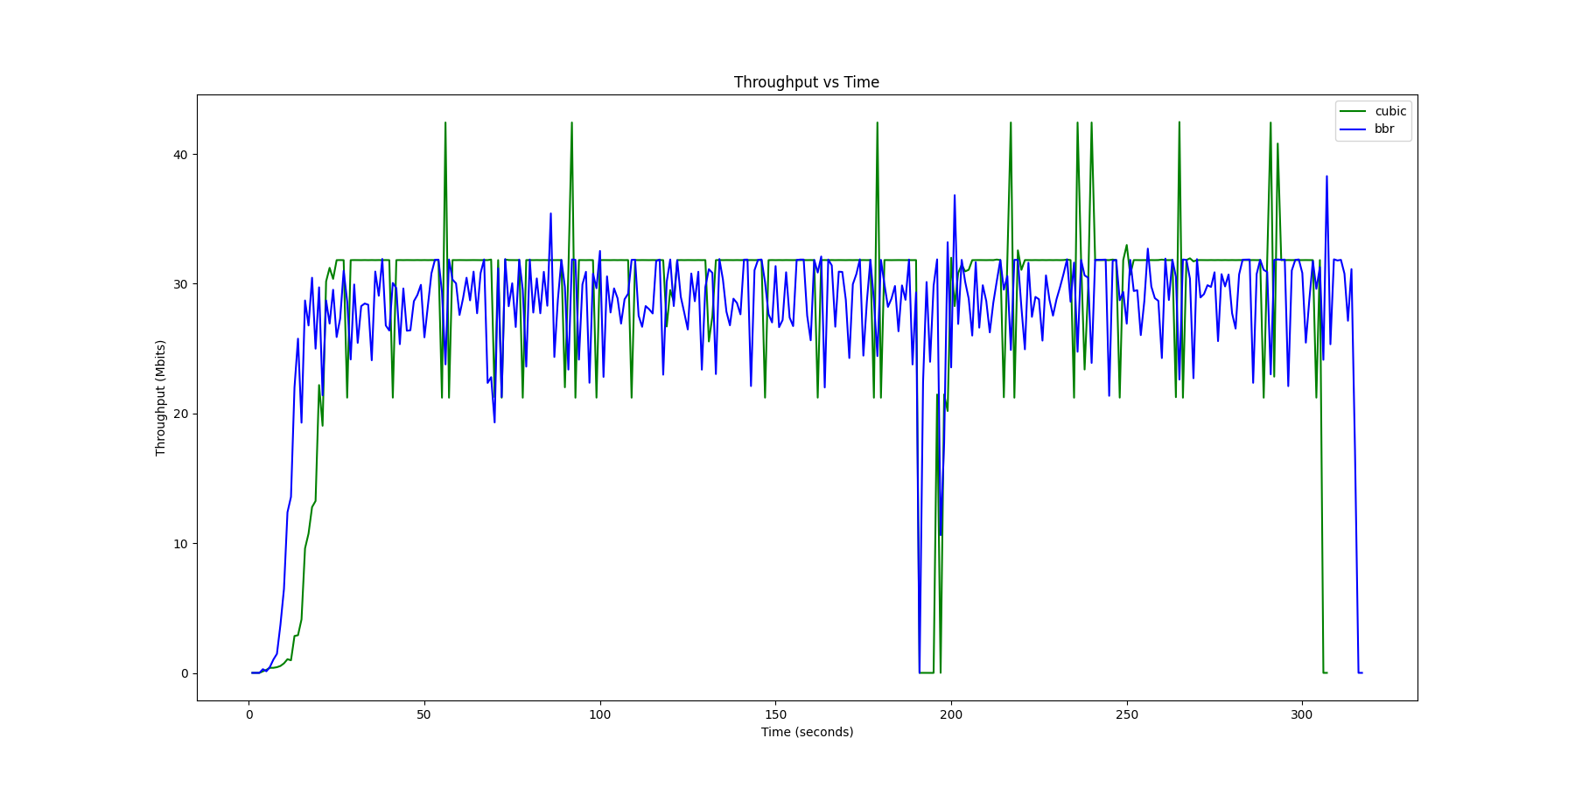
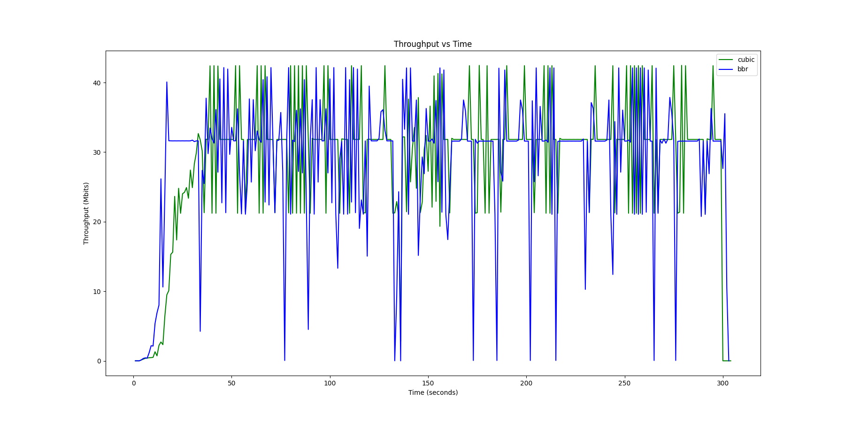
Example Graphs

Slide 18
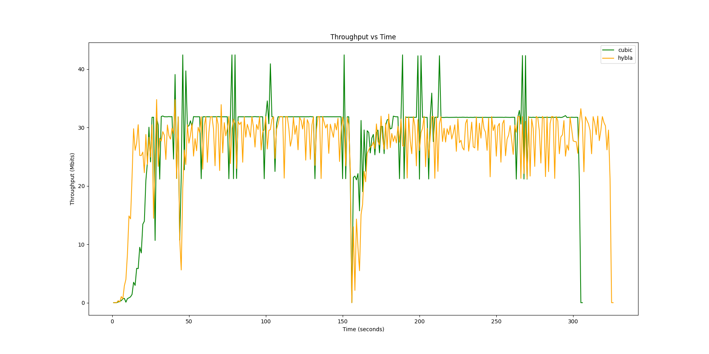
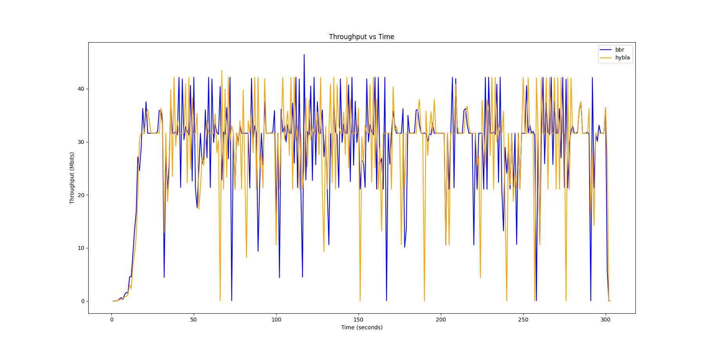
Example Graphs

Slide 19
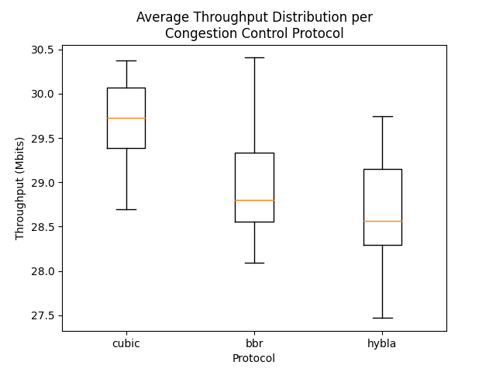
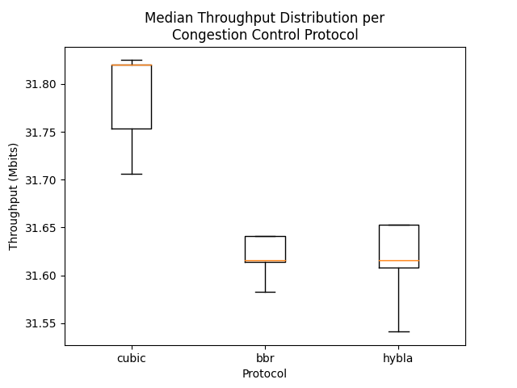
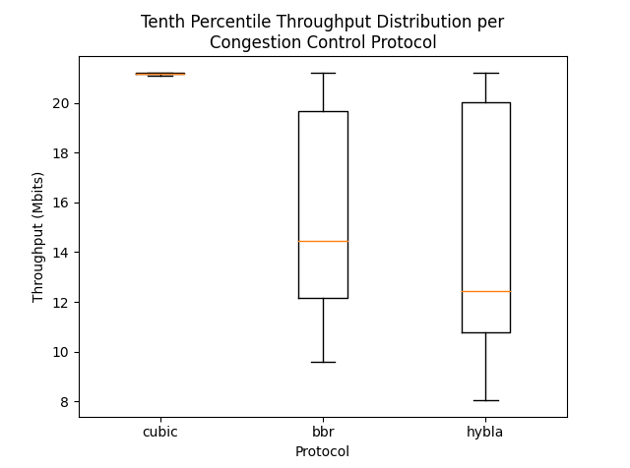
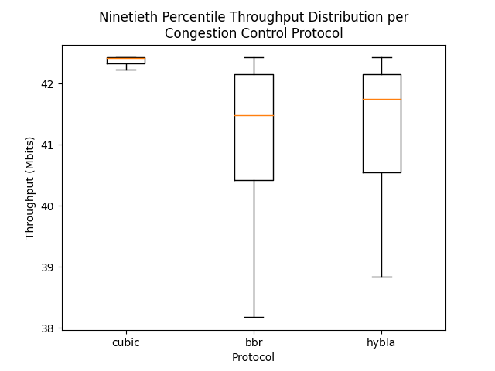
Summary

Slide 20
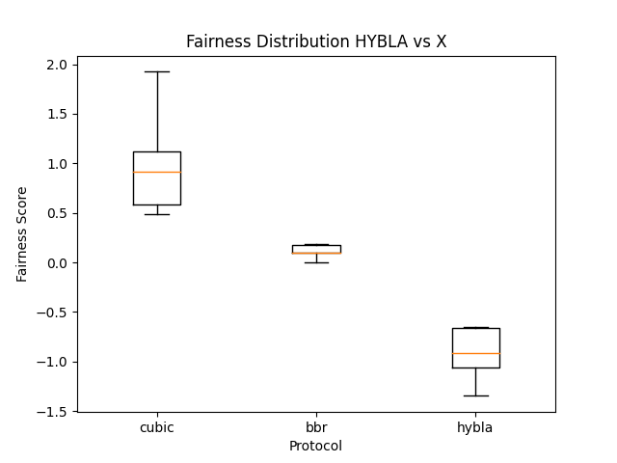
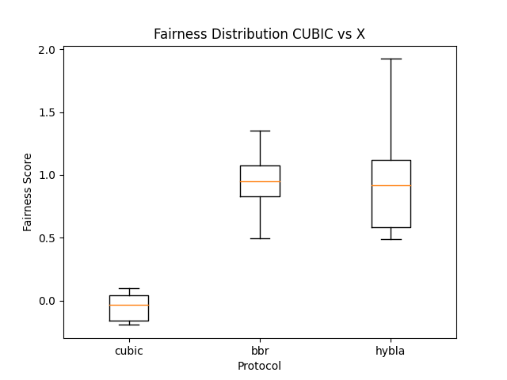
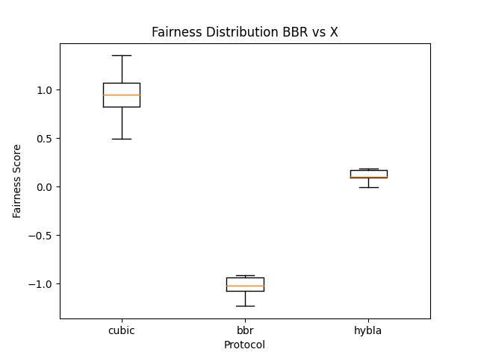
Fairness Summary

Slide 21
Extensions
Stagger Start
RTT analysis
Longer experimental phase

